Slide 1



Explainable AI with SHAP
Unlocking insights through SHAP

Slide 2


Unlocking the Power
of SHAP
Key Points:
Use SHAP (SHapley Additive exPlanations) for model interpretability.
Identify top drivers of predictions using global & local explanations.
Apply SHAP to the trained XGBoost model from Day 5.
Using SHAP tools such as Beeswarm, Bar, dependence plots.

Slide 3
Learning Objectives
Define interpretability, feature attribution, global vs local explanations.
Compute SHAP values for tree-based models.
Generate & interpret beeswarm, bar, and scatter plots.
Use SHAP to identify energy consumption drivers.
Recognize SHAP’s limitations in practice.

Slide 4


The Importance of Explainability
Builds stakeholder trust and mitigates regulatory risks

Slide 5
Why Explainability
Matters
Builds stakeholder trust (e.g., utility billing).
Avoids regulatory risks (e.g., GDPR’s “right to explanation”).
Supports debugging and feature leakage detection.
Example: A demand forecast fails due to real-time data unavailability. SHAP reveals hidden reliance.

Slide 6



Understanding SHAP: Feature Attribution Simplified
SHAP in a Nutshell
Shapley Formula:
SHAP utilizes Shapley values for accurate feature attribution in predictions.
SHAP explains predictions by attributing contributions to each feature

Slide 7


Loading Data & Computing SHAP
Implementation
1. Use XGBoost + TreeExplainer for fast computation
2. Sample 10 rows for fast computation & performance

Slide 8
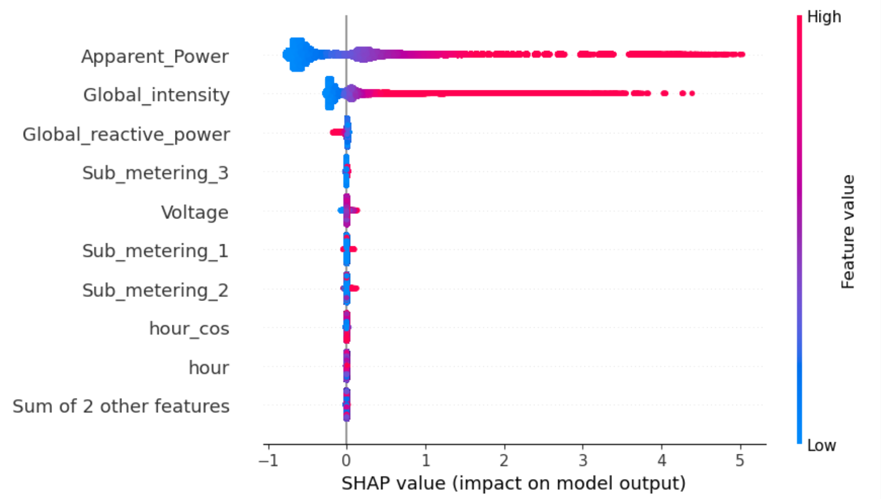
Beeswarm Plot (global feature and impact)
Understanding
SHAP
Visualizations
Beeswarm plots show feature importance and distributions of SHAP values.
Global snapshot – each dot is one row of data
Horizontal spread ⇒ impact size (right = raises prediction, left = lowers prediction)
Colour ⇒ original feature value (red = high, blue = low).

Slide 9
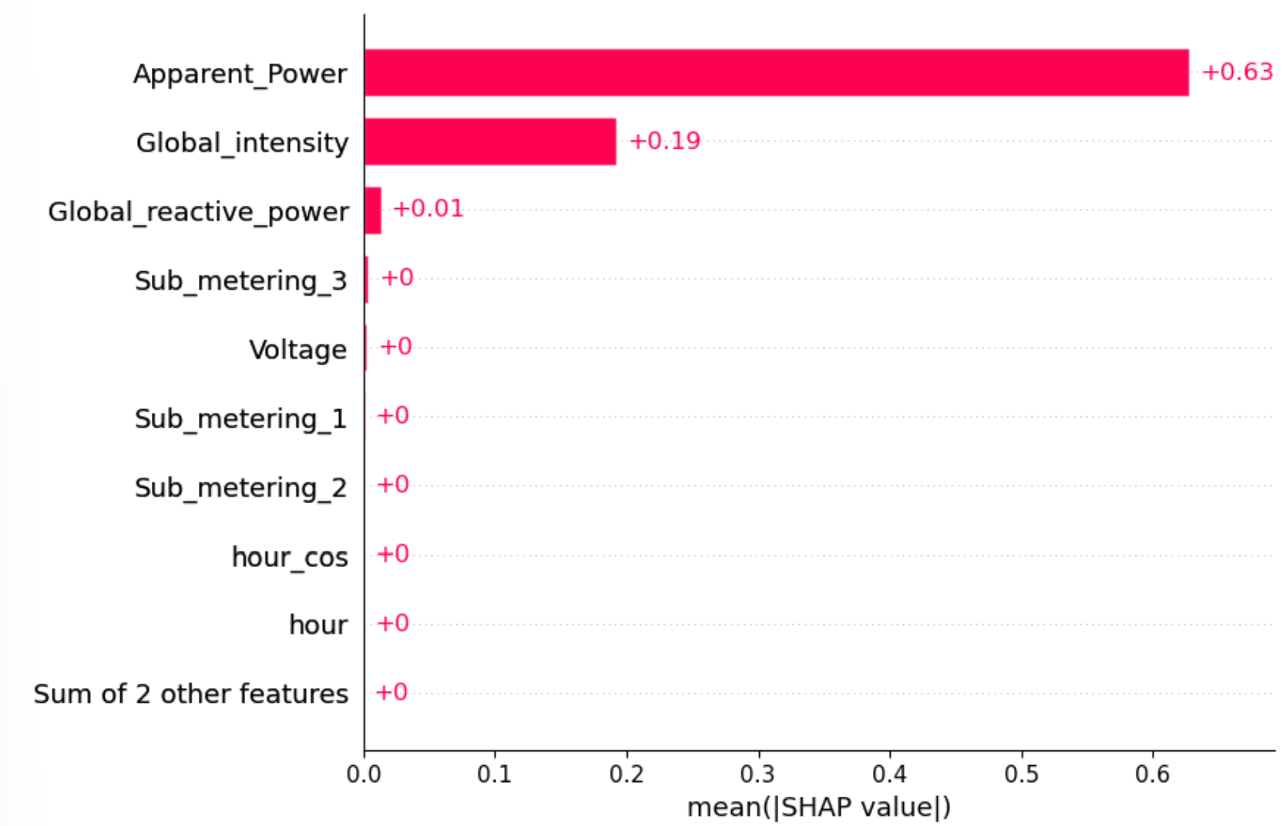
Understanding
SHAP
Visualizations
Bar Plot (ranked mean |SHAP| )
Bar plots provide clear comparisons of feature
contributions to model predictions.
Mean |SHAP| ranks overall importance.
Fast “top-10 drivers” view for executives.
Good starting point before deeper dives.

Slide 10
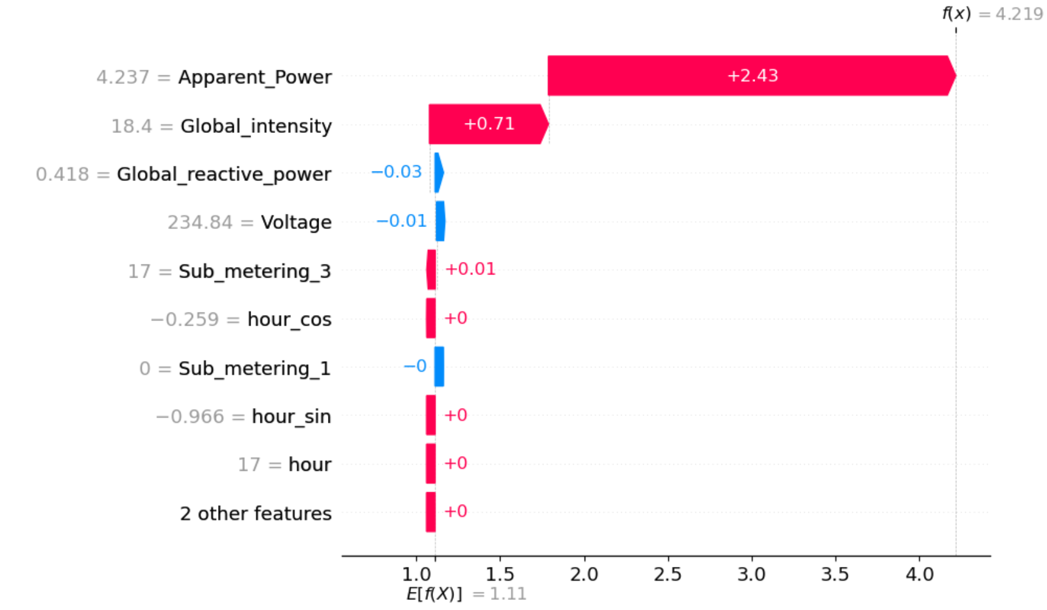
Understanding
SHAP
Visualizations
Waterfall Plot (single prediction explanation)
Waterfall plots decompose an individual prediction into contributions from each feature.
- Bars: Show how each feature pushes the prediction from the base value toward the final output.
- Explains why a specific prediction was made.
- Ideal for auditing model decisions at the individual case level.
- Very useful in regulated settings (e.g., healthcare, finance) where interpretability is required.

Slide 11
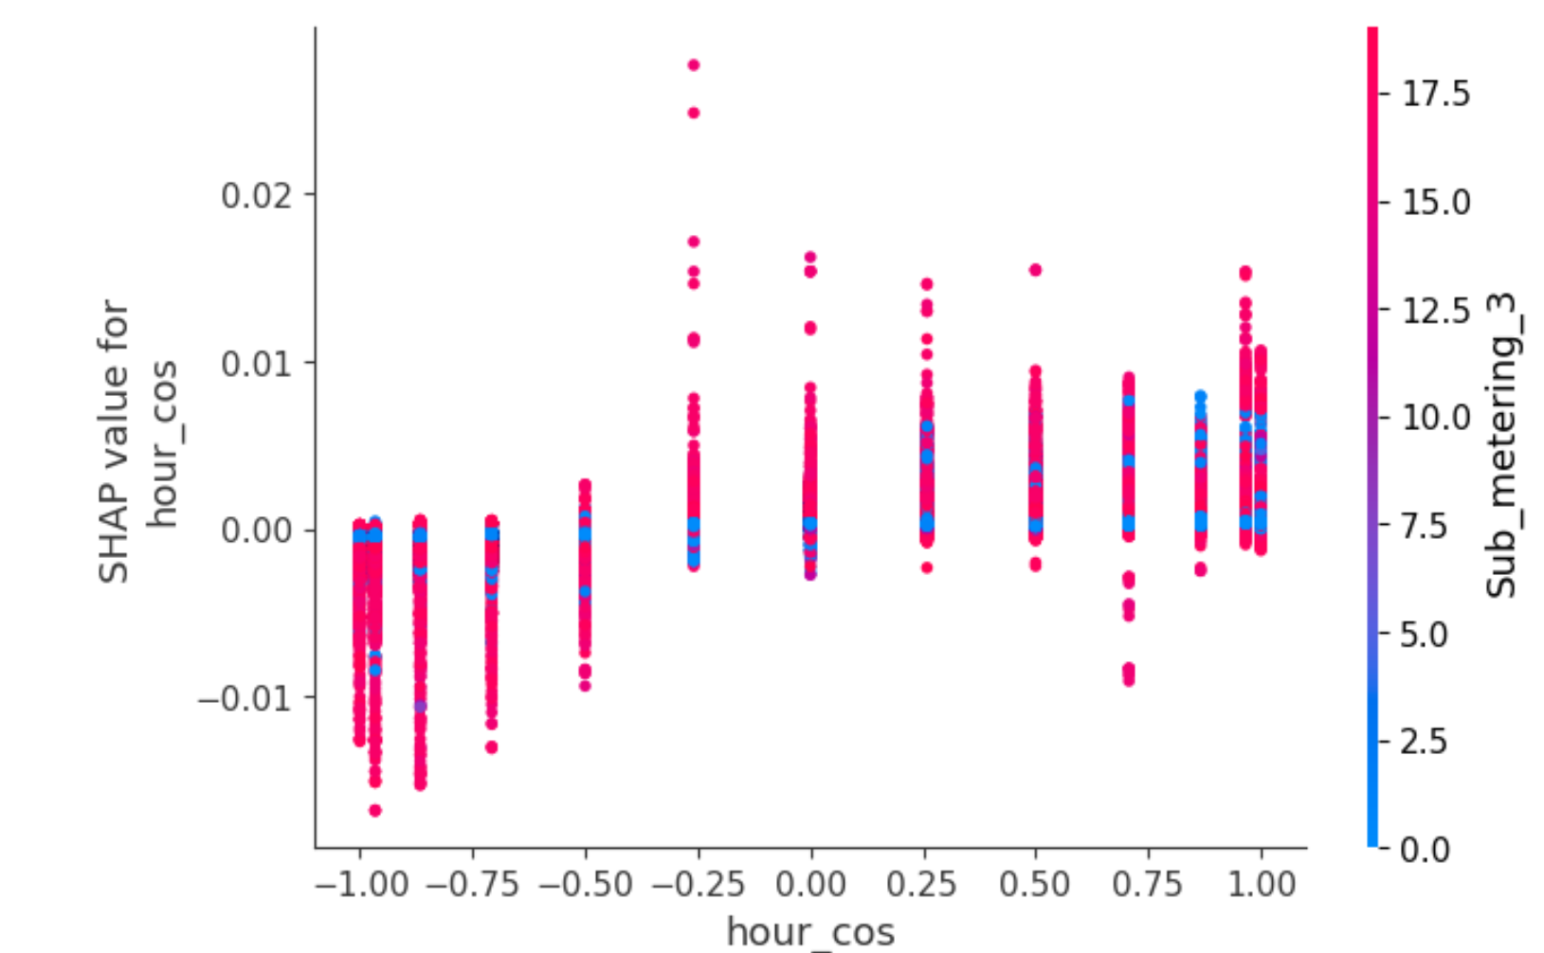
Understanding
SHAP
Visualizations
Dependence Plot (feature interactions)
Dependence plots show how the SHAP value of a feature changes with its value, while also visualizing interaction effects.
- X-axis: The value of a selected feature.
- Y-axis: SHAP value (impact on model output).
- Color: (Optional) Interaction feature (auto-selected by SHAP if not specified).
- Helps identify non-linear effects and potential interactions between features.
- Great for understanding marginal effects of a feature across the dataset.

Slide 12
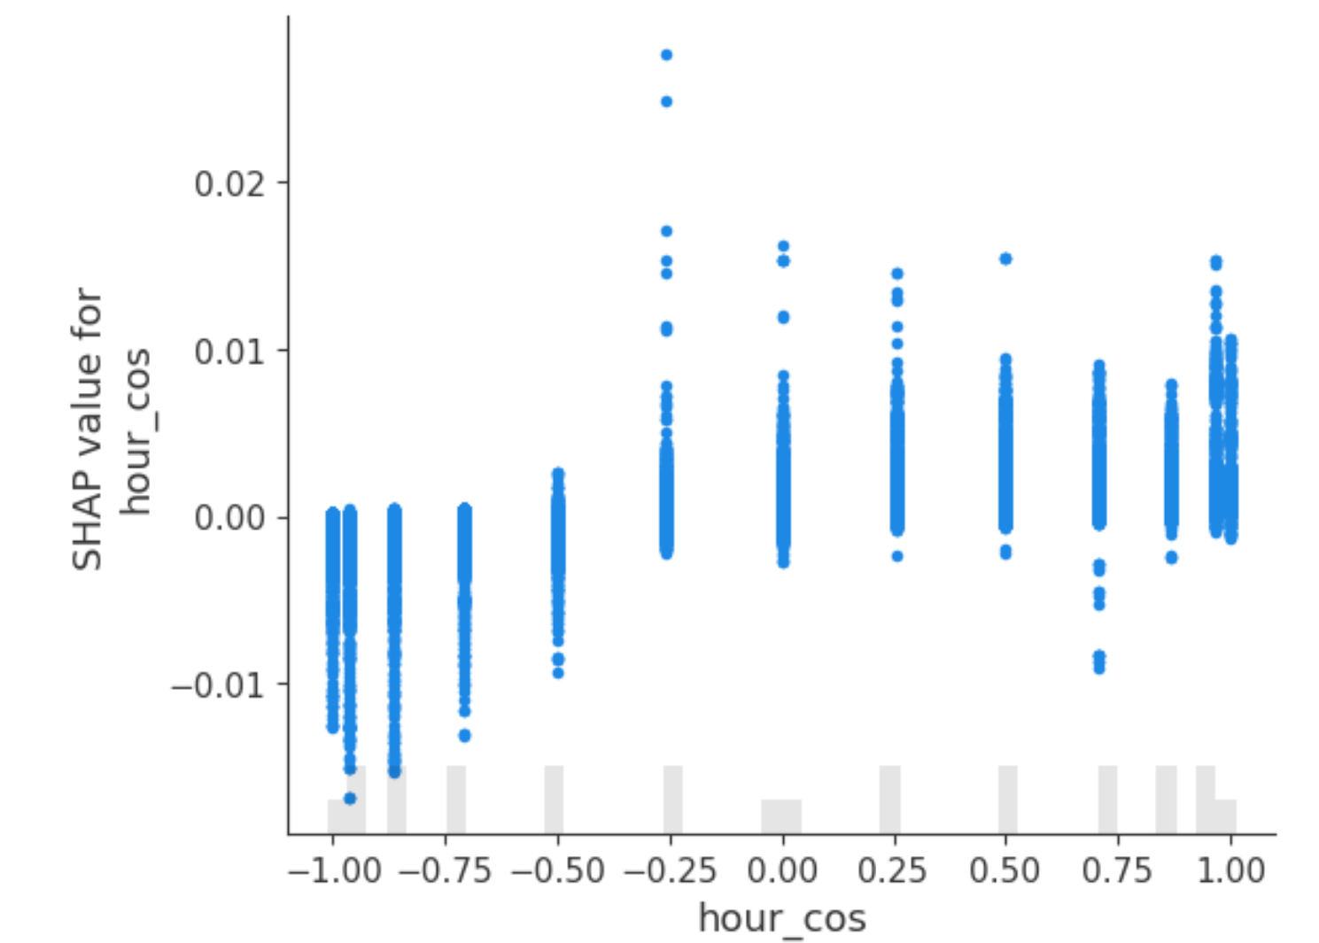
Understanding
SHAP
Visualizations
Scatter Plot (single-feature SHAP values)
SHAP scatter plots focus on one feature and how its values affect model predictions.
- X-axis: Feature values (e.g., `hour_cos`).
- Y-axis: Corresponding SHAP values.
- Unlike dependence plots, this does not include interaction coloring.
- Clean, focused view of how a feature individually contributes to prediction shifts.
- Useful when you want to drill into one specific feature's behavior.

Slide 13


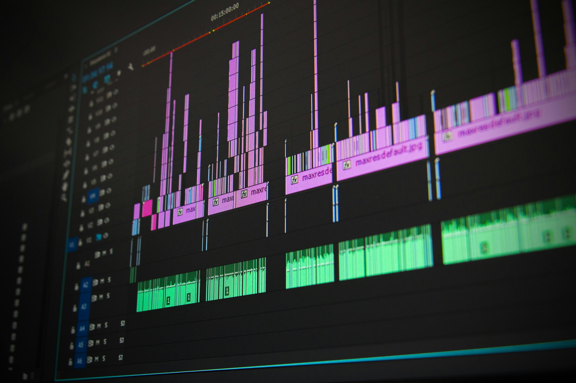
Real World Case Study
SHAP insights for municipal utilities yield significant cost savings.
Use Case: Municipal utility introduces dynamic pricing
Insight from SHAP: hour cost & Voltage drive peak loads at 18:00
Action: Shift tariffs → 💰 Saved $120k/year with 3% peak shaving

Slide 14



SHAP Best Practices
Concern | Mitigation
High computation cost | Use sampling or TreeSHAP
Feature correlation | Use SHAP interaction values
Model support | Use TreeSHAP for tress, KernelSHAP for others

Slide 15


Compute SHAP values using your dataset
Generate visual plots for results
Reflect on the insights gained
Bonus interaction with peers for discussion
Compare SHAP results with traditional methods
Document your findings for future reference
Explore additional resources for deeper understanding
Share results with the class for feedback
Lab Tasks for
SHAP Analysis
Engage with practical tasks to understand SHAP better

Slide 16


“SHAP bridges accuracy and trust”
By translating feature importance into visual, human-understandable insights, SHAP empowers:
1. Analysts
2. Policy makers
3. Engineers

Slide 17
Thank You For Listening
The End

